Slide 1

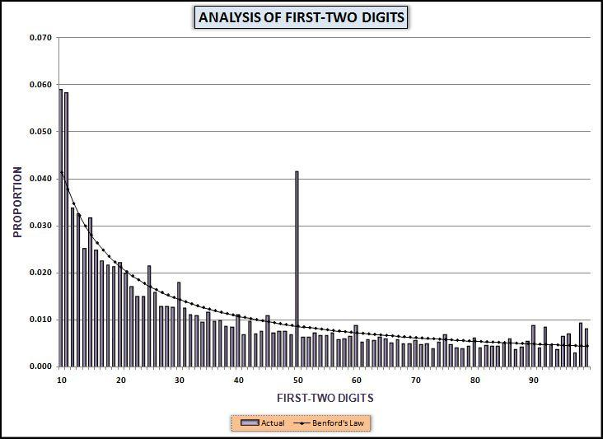
Chapter 5
Benford’s Law formulas
Benford’s Law research
The basic digit tests
Access steps
Prepared by:
Mark J. Nigrini
Copyright © 2012 by Mark J. Nigrini. All rights reserved.
Notes:
Pages 85 to 108.
The basics of Benford’s Law including running the tests in Access.

Slide 2
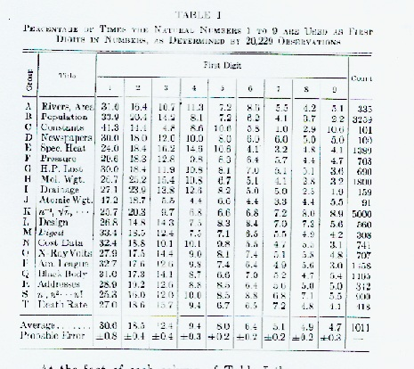
Benford’s original table
Notes:
Not in the book.
Benford’s original results in his 1938 publication. The data set descriptions are brief and bit blurred.
His study is described at the bottom of page 86 and the top of page 87. In the bottom left we can see that 30.6 percent of the numbers started with the digit 1 and 18.5 percent of the numbers started with the digit 2.

Slide 3
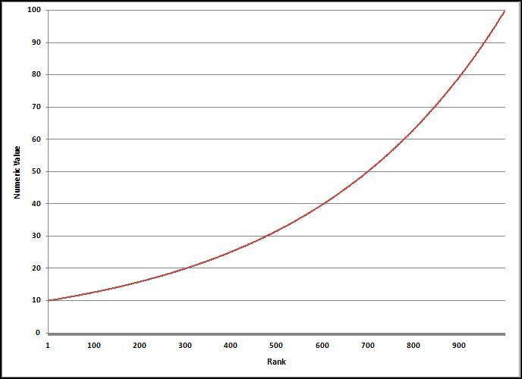
Benford’s hypothesis
Notes:
Page 88.
Figure 5.1
Benford hypothesized that if we take a set of data and rank the numbers from smallest to largest. The rank (1, 2, 3, N) is plotted on the x-axis and the numeric values are plotted on the y-axis then we would get a geometric sequence.

Slide 4
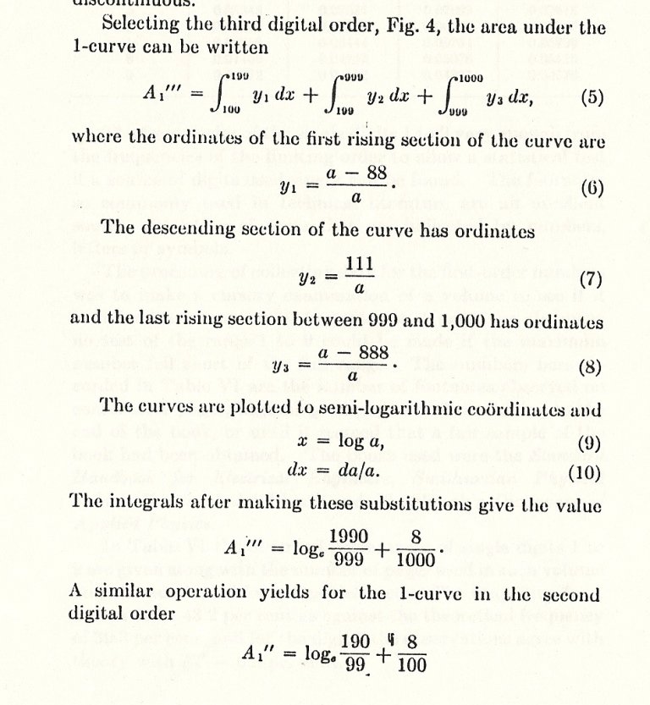
a bit of calculus
Notes:
Not in the book.
Last sentence on page 88. Benford used calculus to derive the expected digit frequencies.
No need to explain the calculus, but the calculus uses integration to get the area under the curve, and the second last calculation on the page (below (10)) simplifies to about log(2) which is the first digit 1 expected probability of 0.30103.

Slide 5
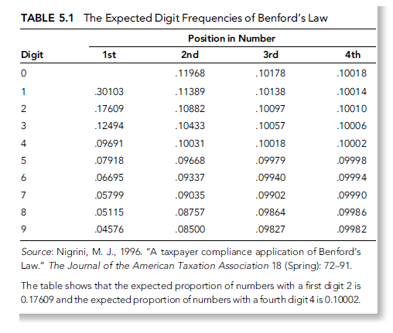
benford’s law
Notes:
Page 88.
Table 5.1.
The expected frequencies for the digits in the first, second, third, and fourth positions is shown in Table 5.1. As we move to the right the digits tend towards being equally distributed. If we are dealing with numbers with three or more digits then for all practical purposes the ending digits (the rightmost digits) are expected to be evenly (uniformly) distributed.

Slide 6
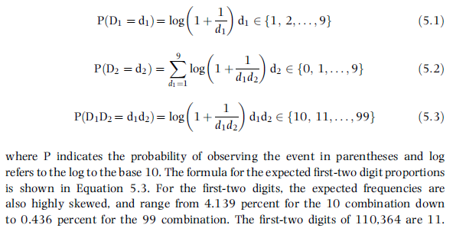
the formulas
Notes:
Page 87.
Equations 5.1 to 5.4.
The first digit, second digit, and first-two digit formulas.

Slide 7
literature to 1980
1948, mental numbers
1960, scale invariance (x by a constant)
1965, can’t use middle 3 digits as random numbers
1969, article in Scientific American
1971, first Fibonacci numbers paper
1972, use Benford to test forecasts
1976, Raimi’s review paper
Notes:
Pages 89 to 92.
Literature review. The most important early paper was by Pinkham.

Slide 8
literature 1980 to 2000
1988, rounding up of accounting numbers
1988, invented numbers
1989, U.S. study of accounting numbers
1992, rounding up of EPS numbers
1995, random samples from random distributions are Benford
1996, tax evasion application
1997, auditing application
1999, Journal of Accountancy article
Notes:
Pages 92 to 97.
Literature review. The most important early paper was by Pinkham.

Slide 9
conformity to Benford
Numbers should represent the sizes of facts or events
No built-in maximum or minimum
Numbers should not be identification numbers (bank account numbers or flight numbers)
Notes:
Pages 97 to 98.
Literature review. The most important early paper was by Pinkham.

Slide 10
invoice amounts
Notes:
Pages 99 to 102.
Figure 5.2.
The basic digit tests are tests of the (1) first digits, (2) second digits, and (3) first-two digits. These tests are also called the first-order tests. The first-order tests are usually run on either the positive numbers, or on the negative numbers. The positive and negative numbers are evaluated separately because the incentive to manipulate is opposite for these types of numbers.
The first-two digit graph shown in Figure 5.2 is from an analysis of the digit frequencies of the invoice amounts for 2007 for a city in the Carolinas. The city government had about 250,000 transactions for the year. The fit to Benford's Law is excellent. The spikes that are evident at some of the multiples of 5 (15, 25, 30, 40, 50, 75, and 80) are quite normal for payments data.

Slide 11
first-two digit findings
Spike at 24 when vouchers are needed @ $25
Spikes below psychological cutoffs of 48, 49, 98, and 99
Systematic frauds, e.g., credit card balances
Comparing two inventory sheets
Spike at 14 for U.K. revenue numbers
Spike at 24 for purchasing cards
Spike at 48 for employee reimbursements
Notes:
Pages 101 to 102.
Selected findings.

Slide 12
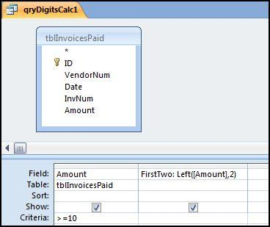
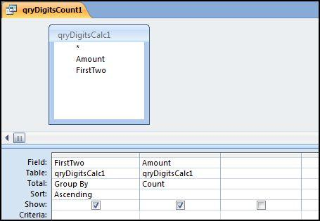
first-two digits: access
Notes:
Pages 102 to 107.
Figures 5.3 and 5.4.
The first query calculates the first-two digits of each number >= 10. The second query counts how many times each digit occurs.

Slide 13
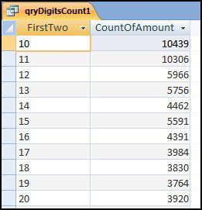
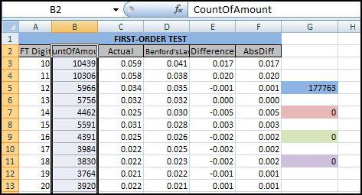
first-two digits: access
Notes:
Pages 102 to 107.
Figures 5.5 and 5.6.
The results of the second query are copied and pasted into an Excel template.

Slide 14
first-two digits: access
Notes:
Page 106.
Figure 5.7.
The result of the analysis (an Excel graph).
With a union query we'll run the seven strata queries at the same time by changing the criteria. For example, the criterion for the first stratum is ">=10," and the criterion for the second stratum is "Between 0.01 and 9.99." To stack the queries on top of one another we need to (1) delete the semi-colon and move it to the end of the query, (2) insert the word "Union" (without the quotation marks and preferably in capital letters) between each query, and (3) update the criteria.

Slide 15
summary
Benford’s Law gives the expected frequencies of the digits in tabulated data
Large bias towards the low digits
Some important papers in the 1940 to 2000 period
Applies to data sets that meet the three conditions
Works best on data sets with > 1,000 records
Easy to spot excess activity below control thresholds
Access can calculate the digit frequencies
Excel can be used to graph the results
Notes:
Pages 107 to 108, and a review of the main points.

